Slide 1
Sex & Trans Feminine People:

Slide 2
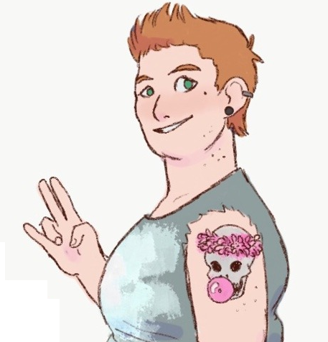
General Info:
Trans feminine people can possess the full range of physical and sexual anatomy - we shouldn’t make assumptions about a trans woman/trans-fem’s body based on her/their gender identity.
Trans feminine people have diverse relationships with their anatomy and how they feel comfortable using it
Many trans feminine people were AMAB and undergo hormone replacement therapy resulting in substantial changes to bodies and genitalia
Many trans feminine people undergo reassignment surgery and have vaginas

Slide 3
Effects of Oestrogen:
Oestrogen typically reduces need to masturbate and, though not necessarily, libido.
The penis often becomes softer and it can be harder/take longer for it to become erect
Ejaculation fluid reduces and grows translucent (less sperm!) It becomes more like a lubricant!
Can cause shift erogenous zones
But remember, it’s different for everyone!

Slide 4
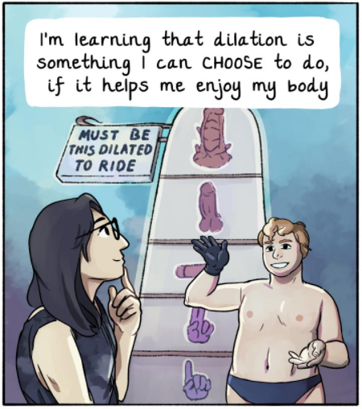
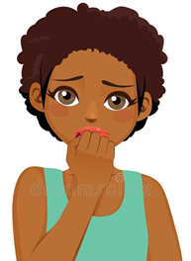
Effects of Reassignment Surgery:
MTF vaginas can have varying levels of self-lubrication – lubricate appropriately, as with any other vagina
MTF vaginas and vulvas are diverse! They vary in size, appearance, etc.
MTF vaginas maintain length through regular dilation. Not all trans women/fems dilate, and may alternate dilation schedules
How do I explain I want when I’m still learning how my new parts work?
Source: ohjoysextoy https://www.ohjoysextoy.com/dilating-after-by-naomi-rubin/?fbclid=IwAR1AA1RcyWdxrXqHyDhvakQj5QcGLsADQIoHrGSjl-xW4yY9G1AoGMZ6YwI

Slide 5
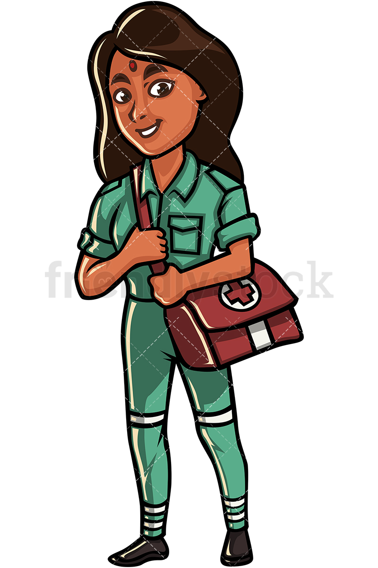
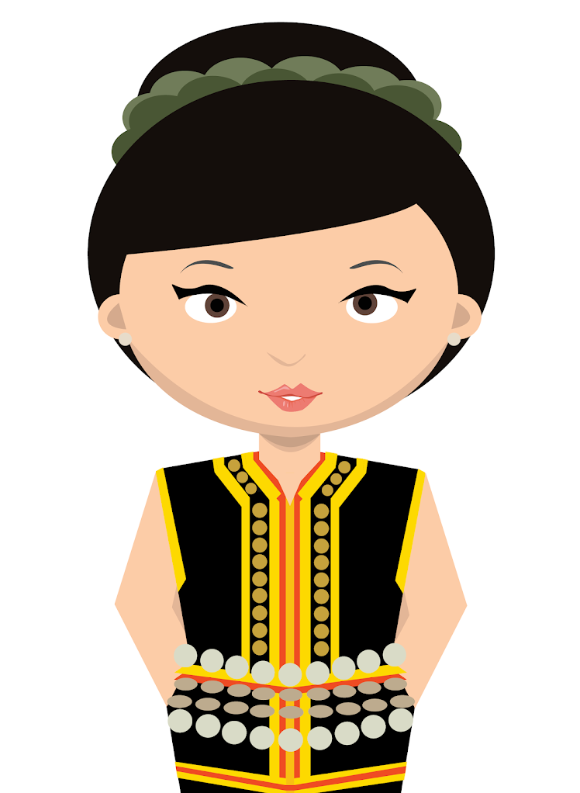
Navigating Sex:
Shifts in self-identity can have major, sudden and unexpected impacts on how a person prefer or feel comfortable engaging with sex. These things can always evolve!
It can take time after reassignment surgery to feel comfortable with new anatomy! Going slow is fine!
Experimentation is critical – consider exploratory masturbation, using a vibrator, and engaging alternative erogenous zones (e.g. butt, hip bones, navel, you name it!)
I still love it! Sex hasn’t changed much for me!
I used to love penetrative sex – now I can’t stand it!
I’m an explorer!

Slide 6
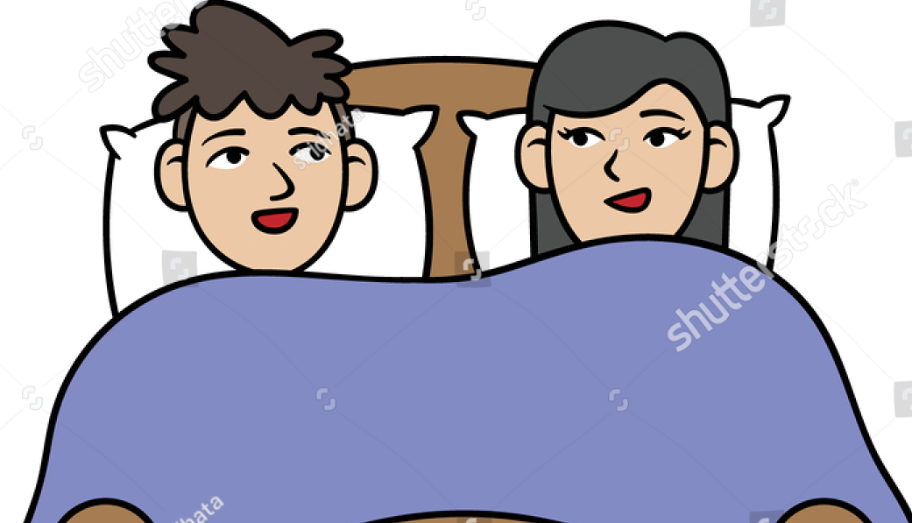
Safety:
Personal safety is a priority!
Unless you or your partner has had their reproductive organs removed, nobody knows for sure that they are medically infertile!
Penetration of any sort can risk STDs, so safety first!
I know it feels uncomfortable for you to wear a condom as a woman – shall we see if we enjoy non-penetrative sex with out clothes on?
That’s so crazy it might just work!

