Slide 2
Sex Between People with Penises

Slide 3
What is Sex?
Oral Sex
- Rimming & blowjobs
Hand sex
Fingering & hand jobs
Anal sex
Using sex toys

Slide 4
Cum-munication ; )
Proper communication goes for all kinds of sex.
If your partner is doing something you don’t like, like pushing your head down in oral sex, stop and tell them. Don’t keep going. One little sentence will make your sex much much better. Equally, if you’re into something tell your partner.
If you’re having unprotected sex decide with your partner beforehand if you’re going to ejaculate in the anus/mouth.

Slide 5
Oral Sex
Rimming
Using your tongue and mouth to stimulate the anus.
The general technique is licking the perineum and rim of the anus
Prep – You don’t need a ’deep clean’ A shower will do. You’re not going to enjoy it if youre constantly worried about if the other person can taste anything.
Finishing – It’s pretty tricky to orgasm from rimming alone but it’s useful to pair with something else or get your partner used to anal stimulation.
Blowjobs
Stimulating the penis with your mouth
Preparation – basic hygiene tbh
Protection:

Slide 6
Hand / genital sex
Hand / penis stimulation
(hand-jobs)
‘Uncut’ – foreskin moves.
‘Cut’ – dry handjobs vs lubricant.
Hand / anus stimulation
(fingering)
Its own sex act
Prep – ideally the same as anal sex. Thorough clean & perhaps worth douching, especially if you’re working up to inserting sex toys or anal.
Safety – minimal risk of transmitting STI’s but not impossible.
Hygiene – wash your hands. NO HAND SAN. Short nails.

Slide 7
Anal Sex
Anal Sex
necessary?
communication
preparation
condoms
lubrication (water v oil based)

Slide 8
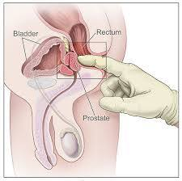
The elusive prostate????????

Slide 9
Anal Sex
Necessary ?
Prep
Washing / showering
Douching (optional)
Lubricant – water based if using protection or sex toys
Fingering / stretching – build up
Experience determines how much prep you need
Protection

Slide 10
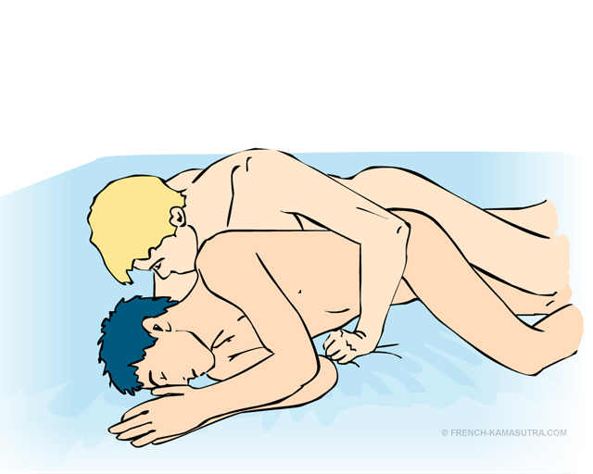
Anal positions

Slide 11
Sex Toys
Using sex toys
condoms
lubrication
Preparation
Cleaning

Slide 12
Hepatitis
If you are regularly having sex which involves the anus i.e. rimming, sharing sex toys, and giving oral after anal sex you are at increased risk of contracting Hepatitis A, B, and C.
These are all viral infections which have effects on the liver, which if untreated can develop into more serious liver diseases.
If you explain that you are at higher risk to your local practice you should be able to get Hep A&B vaccinations. You get 3 shots within a 6-month period, then you get a top-up vaccination every couple of years.
Just get it !!!

